Slide 1


Rodrigo Cabada Rodriguez
04 December 2024

Slide 2

Outline
Executive Summary
Introduction
Methodology
Results
Conclusion
Appendix

Slide 3
Executive Summary
Summary of methodologies
Space X Data collection API
Space X Web Scraping Falcon 9
Space X Data Wrangling
Space X EDA using SQL
Space X EDA DataViz Using Pandas and Matplotlib
Space X Launch Sites Analysis with Folium Interactive Visual Analytics and Ploty Dash
Space X Machine Learning Prediction
Summary of all results
EDA results
Interactive Visual Analytics and Dashboards
Predictive Analysis

Slide 4
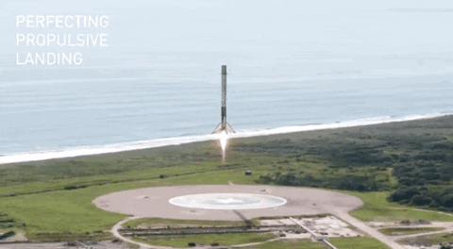
Introduction
Project background and context
SpaceX advertises Falcon 9 rocket launches on its website with a cost of 62 million dollars; other providers cost upward of 165 million dollars each, much of the savings is because SpaceX can reuse the first stage. Therefore if we can determine if the first stage will land, we can determine the cost of a launch. This information can be used if an alternate company wants to bid against SpaceX for a rocket launch.
Problems you want to find answers
In this capstone, we will predict if the Falcon 9 first stage will land successfully using data from Falcon 9 rocket launches advertised on its website.

Slide 5

Section 1

Slide 6
Methodology
Executive Summary
Data collection methodology:
SpaceX API
Web Scrap of link: List of Falcon /9/ and Falcon Heavy launch records from Wikipedia
Perform data wrangling
Determined labels for training the supervised models by converting mission outcomes in to training labels (0-unsuccessful, 1-successful)
Perform exploratory data analysis (EDA) using visualization and SQL
Perform interactive visual analytics using Folium and Plotly Dash
Perform predictive analysis using classification models
Created a column for ‘class’; standardized and transformed data; train/test split data; find best classification algorithm (Logistic regression, SVM, decision tree, & KNN) using test data

Slide 7
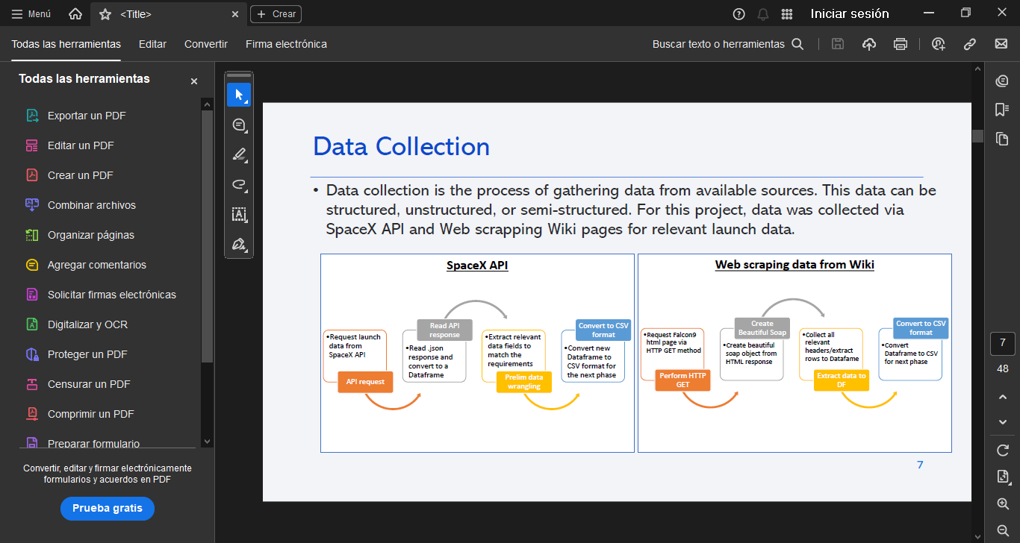
Data Collection
Data collection is the process of gathering data from available sources. This data can be structured, unstructured, or semi-structured. For this project, data was collected via SpaceX API and Web scrapping Wiki pages for relevant launch data.

Slide 8
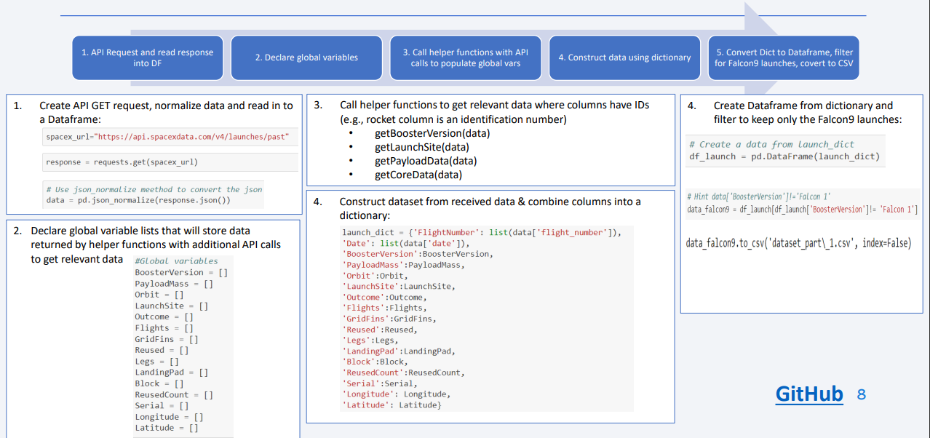

Data Collection – SpaceX API
8
GitHub Link
1- Space X - Data Collection API

Slide 9
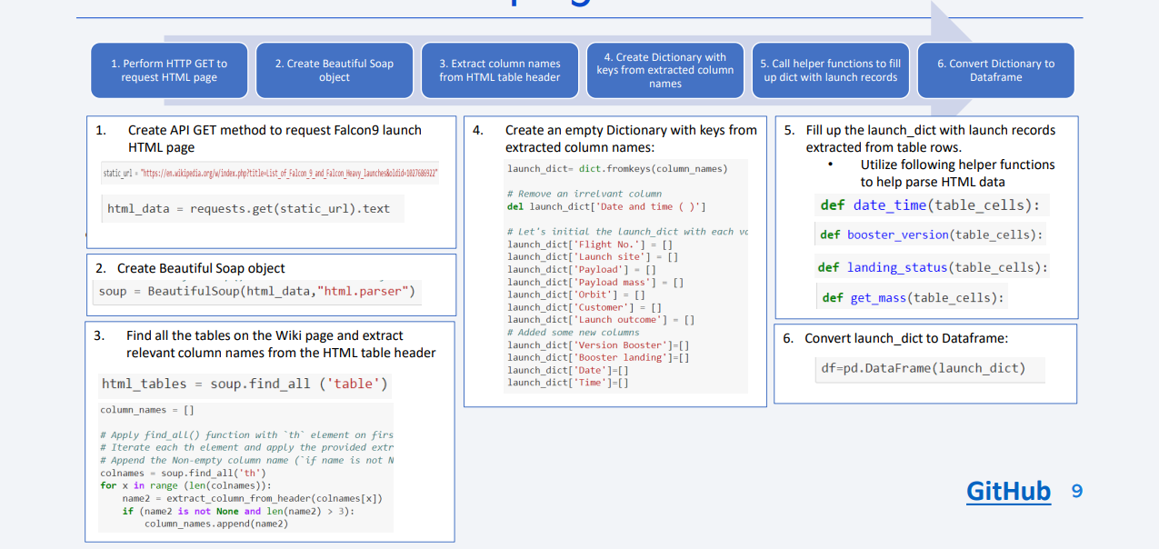

Data Collection - Scraping
GitHub Link:
2 - Space X - Web scraping Falcon 9 and Falcon Heavy Launches Records from Wikipedia.

Slide 10
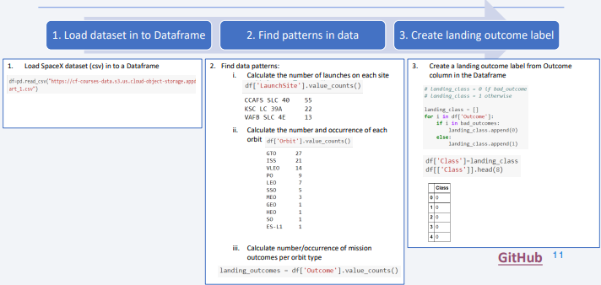
Data Wrangling
Conducted Exploratory Data Analysis (EDA) to find patters in data and define labels for training supervised models
The data set contained various mission outcomes that were converted into Training Labels with 1 meaning the booster successfully landed and 0 meaning booster was unsuccessful in landing. Following landing scenarios were considered to create labels:
True Ocean means the mission outcome was successfully landed to a specific region of the ocean
False Ocean means the mission outcome was unsuccessfully landed to a specific region of the ocean
RTLS means the mission outcome was successfully landed to a ground pad
False RTLS means the mission outcome was unsuccessfully landed to a ground pad
True ASDS means the mission outcome was successfully landed on a drone ship
False ASDS means the mission outcome was unsuccessfully landed on a drone ship
GitHub Link:
3 - Space X Falcon 9 First Stage Landing Prediction

Slide 11
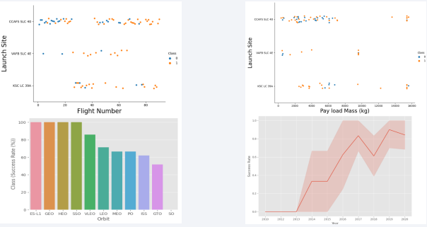
EDA with Data Visualization
• As part of the Exploratory Data Analysis (EDA), following charts were plotted to gain further insights into the dataset:
1. Scatter plot:
• Shows relationship or correlation between two variables making patterns easy to observe
• Plotted following charts to visualize:
• Relationship between Flight Number and Launch Site
• Relationship between Payload and Launch Site
• Relationship between Flight Number and Orbit Type
• Relationship between Payload and Orbit Type
2. Bar Chart:
• Commonly used to compare the values of a variable at a given point in time.
Bar charts makes it easy
to see which groups are highest/common and how other groups compare against each other. Length
of each bar is proportional to the value of the items that it represents
• Plotted following Bar chart to visualize:
• Relationship between success rate of each orbit type
3. Line Chart:
• Commonly used to track changes over a period of time. It helps depict trends over time.
• Plotted following Line chart to observe:
• Average launch success yearly trend
GitHub Link:
4 - Space X - EDA Using SQL

Slide 12
EDA with SQL
To better understand SpaceX data set, following SQL queries/operations were performed on an IBM DB2 cloud instance:
1. Display the names of the unique launch sites in the space mission
2. Display 5 records where launch sites begin with the string 'CCA’
3. Display the total payload mass carried by boosters launched by NASA (CRS)
4. Display average payload mass carried by booster version F9 v1.1
5. List the date when the first successful landing outcome in ground pad was achieved.
6. List the names of the boosters which have success in drone ship and have payload mass greater than 4000 but less than 6000
7. List the total number of successful and failure mission outcomes
8. List the names of the booster_versions which have carried the maximum payload mass. Use a subquery
9. List the failed landing_outcomes in drone ship, their booster versions, and launch site names for in year 2015
10.Rank the count of landing outcomes (such as Failure (drone ship) or Success (ground pad)) between the date 2010-06-04 and 2017-03-20, in descending order EDA with SQL
GitHub Link:
5 - Space X - EDA DataViz Using Pandas and Matplotlib

Slide 13
Build an Interactive Map with Folium
Folium interactive map helps analyze geospatial data to perform more interactive visual analytics and better understand factors such location and proximity of launch sites that impact launch success rate.
• Following map object were created and added to the map:
• Mark all launch sites on the map. This allowed to visually see the launch sites on the map.
• Added ‘folium.circle’ and ‘folium.marker’ to highlight circle area with a text label over each launch site.
• Added a ‘MarkerCluster()’ to show launch success (green) and failure (red) markers for each launch site.
• Calculated distances between a launch site to its proximities (e.g., coastline, railroad, highway, city)
• Added ‘MousePosition() to get coordinate for a mouse position over a point on the map
• Added ‘folium.Marker()’ to display distance (in KM) on the point on the map (e.g., coastline, railroad, highway, city)
• Added ‘folium.Polyline()’ to draw a line between the point on the map and the launch site
• Repeated steps above to add markers and draw lines between launch sites and proximities – coastline, railroad, highway, city)
• Building the Interactive Map with Folium helped answered following questions:
• Are launch sites in close proximity to railways? YES
• Are launch sites in close proximity to highways? YES
• Are launch sites in close proximity to coastline? YES
• Do launch sites keep certain distance away from cities? YES
GitHub Link:
6 - Hands on Lab Interactive Visual Analytics with Folium

Slide 14
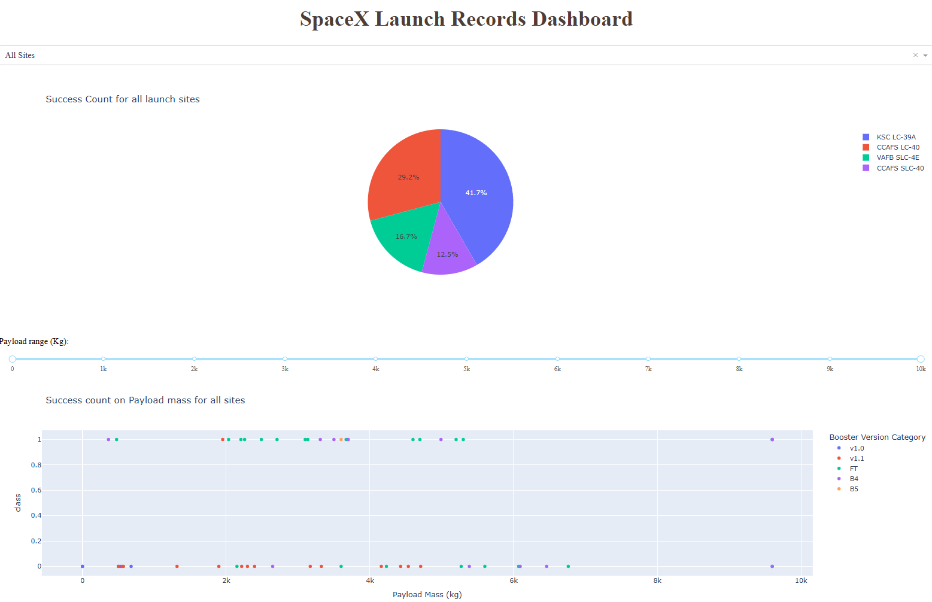
Build a Dashboard with Plotly Dash
• Built a Plotly Dash web application to perform interactive visual analytics on SpaceX launch
data in real-time. Added Launch Site Drop-down, Pie Chart, Payload range slide, and a
Scatter chart to the Dashboard.
1. Added a Launch Site Drop-down Input component to the dashboard to provide an ability to filter
Dashboard visual by all launch sites or a particular launch site
2. Added a Pie Chart to the Dashboard to show total success launches when ‘All Sites’ is selected and
show success and failed counts when a particular site is selected
3. Added a Payload range slider to the Dashboard to easily select different payload ranges to identify
visual patterns
4. Added a Scatter chart to observe how payload may be correlated with mission outcomes for selected
sites. The color-label Booster version on each scatter point provided missions outcomes with
different boosters
• Dashboard helped answer following questions:
1. Which site has the largest successful launches? KSC LC-39A with 10
2. Which site has the highest launch success rate? KSC LC-39A with 76.9% success
3. Which payload range(s) has the highest launch success rate? 2000 – 5000 kg
4. Which payload range(s) has the lowest launch success rate? 0-2000 and 5500 - 7000
5. Which F9 Booster version (v1.0, v1.1, FT, B4, B5, etc.) has the highest launch success rate? FT
GitHub Link:
7 - Hands on Lab build an interactive dashboard with Plotly Dash

Slide 15
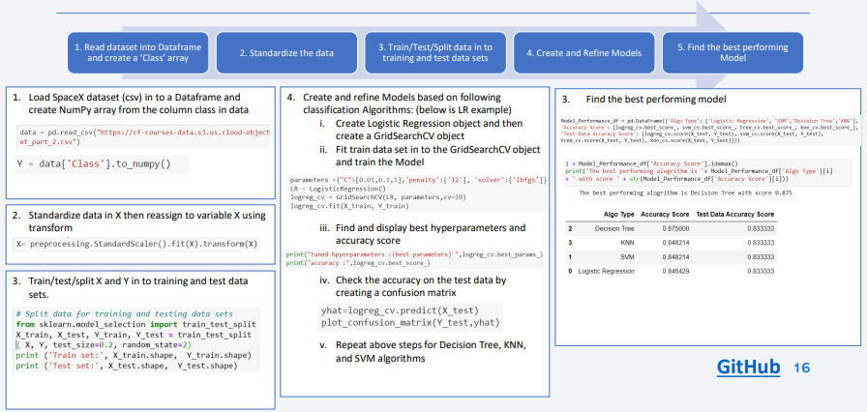
Predictive Analysis (Classification)
GitHub Link:
8 - Hands on Lab Complete the Machine Learning Prediction

Slide 16
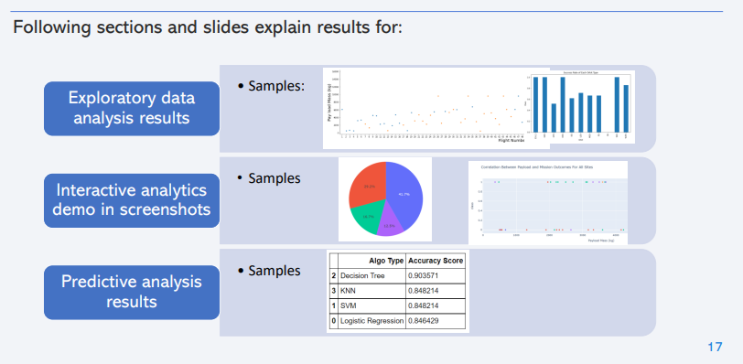
Results

Slide 17

Section 2

Slide 18
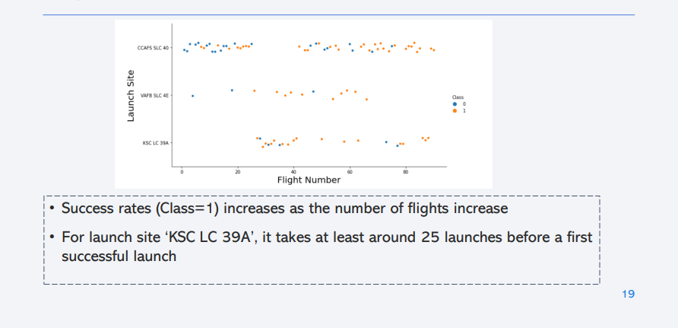
Flight Number vs. Launch Site

Slide 19
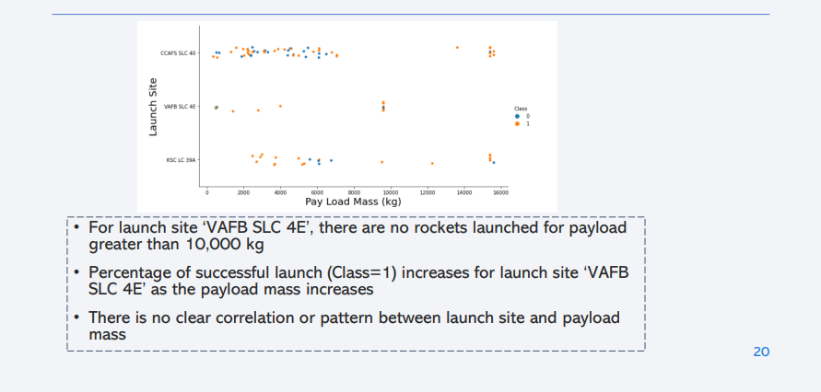
Payload vs. Launch Site

Slide 20
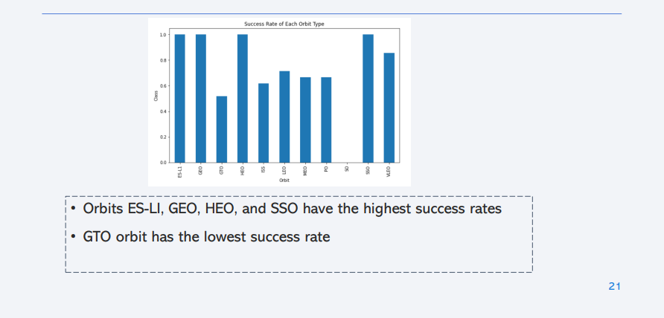
Success Rate vs. Orbit Type

Slide 21
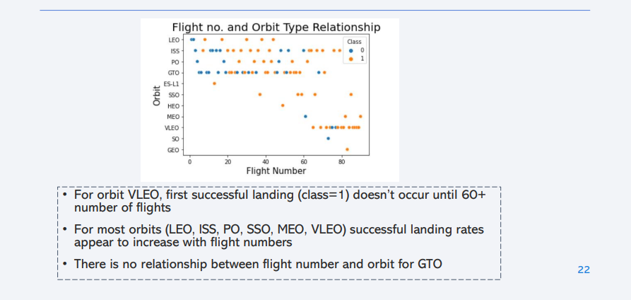
Flight Number vs. Orbit Type

Slide 22
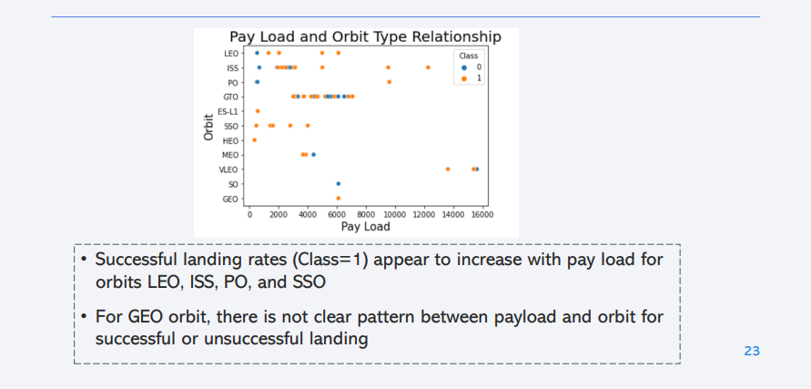
Payload vs. Orbit Type

Slide 23
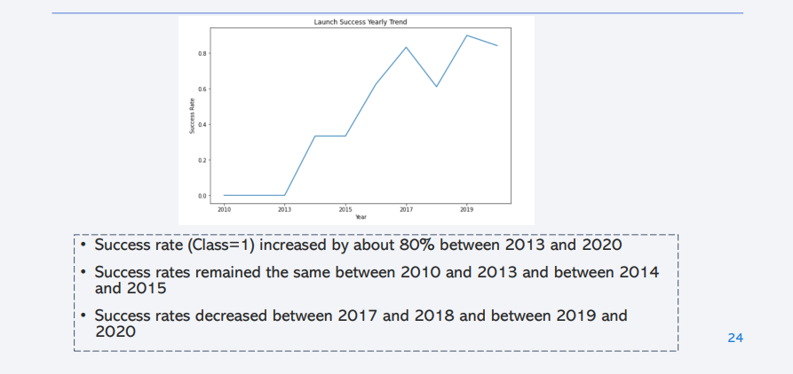
Launch Success Yearly Trend

Slide 24
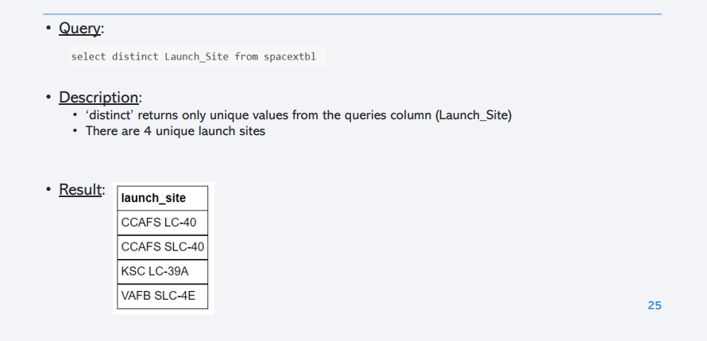
All Launch Site Names

Slide 25
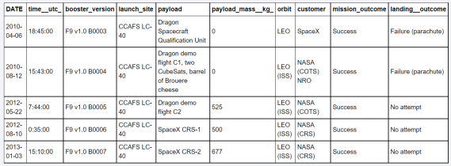
Launch Site Names Begin with 'CCA'
Query:
• Description:
Using keyword ‘Like’ and format ‘CCA%’, returns records where ‘Launch_Site’ column starts with “CCA”.
Limit 5, limits the number of returned records to 5
• Result:

Slide 26
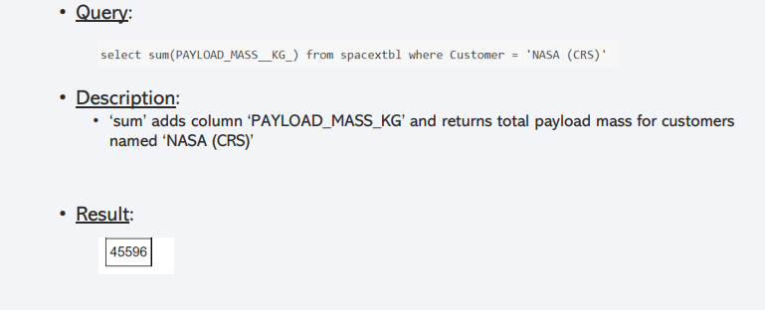
Total Payload Mass

Slide 27
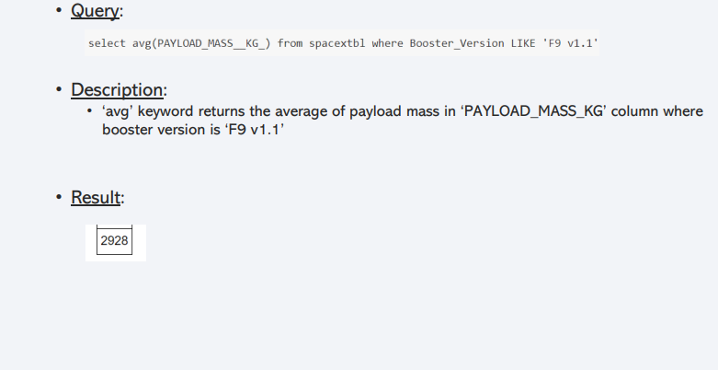
Average Payload Mass by F9 v1.1

Slide 28
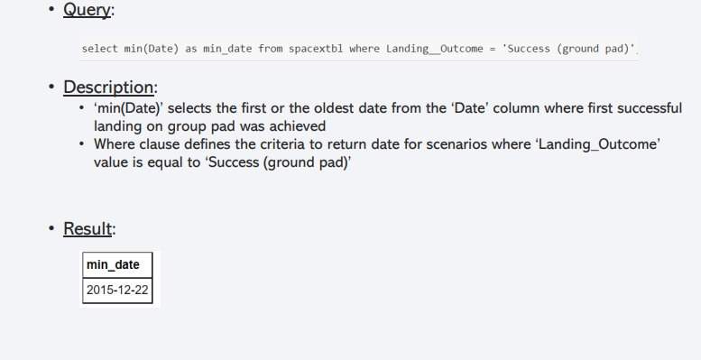
First Successful Ground Landing Date

Slide 29
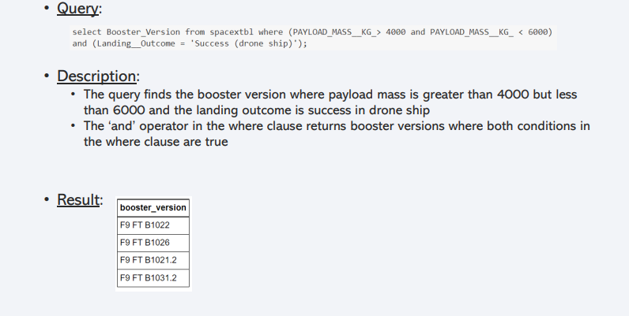
Successful Drone Ship Landing with Payload between 4000 and 6000

Slide 30
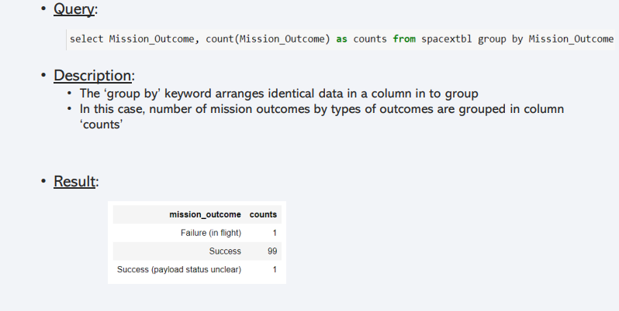
Total Number of Successful and Failure Mission Outcomes

Slide 31
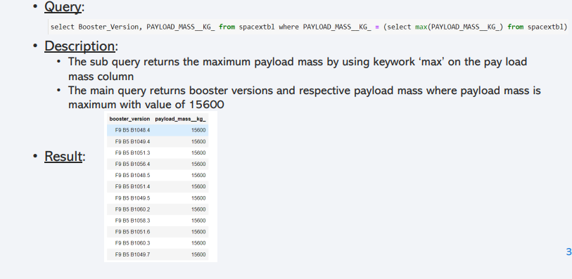
Boosters Carried Maximum Payload

Slide 32
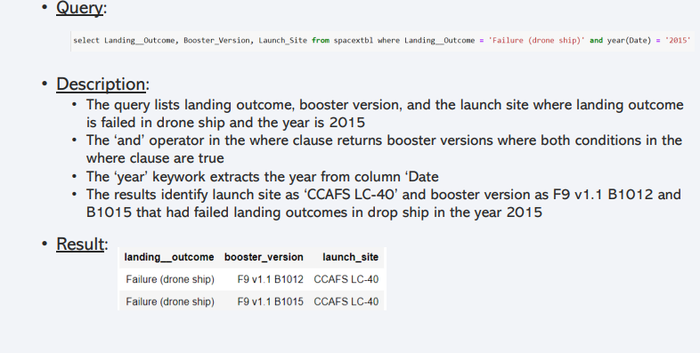
2015 Launch Records

Slide 33
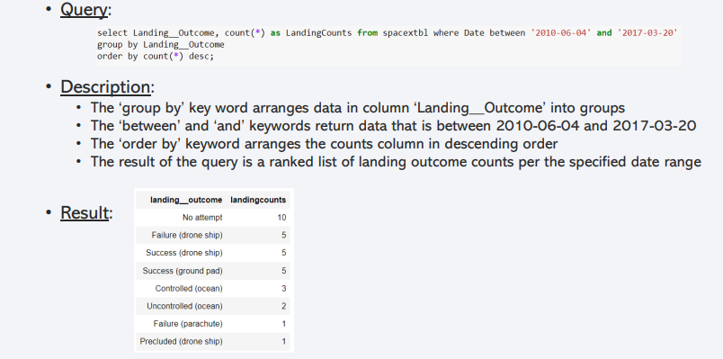
Rank Landing Outcomes Between 2010-06-04 and 2017-03-20

Slide 34

Section 3

Slide 35
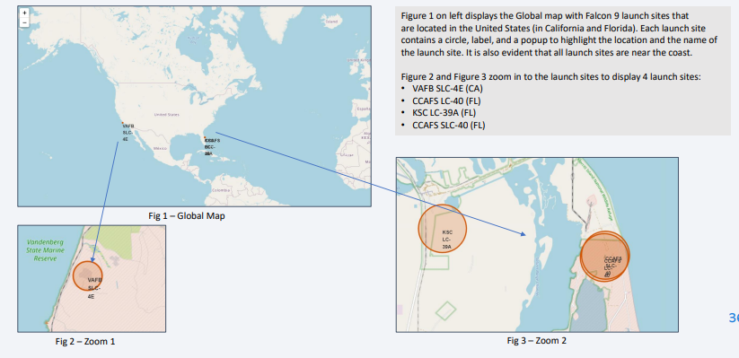
Space X Falcon9 – Launch Sites Map

Slide 36
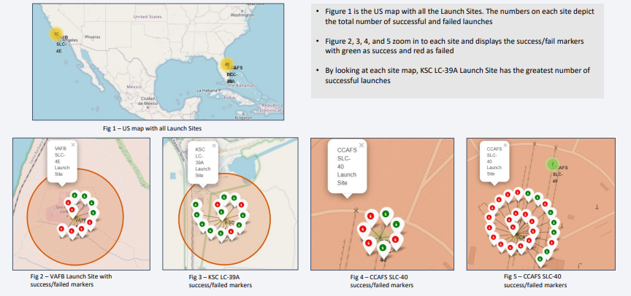
Space X Falcon9 – Success/Failed Launch Map for all Launch Sites

Slide 37
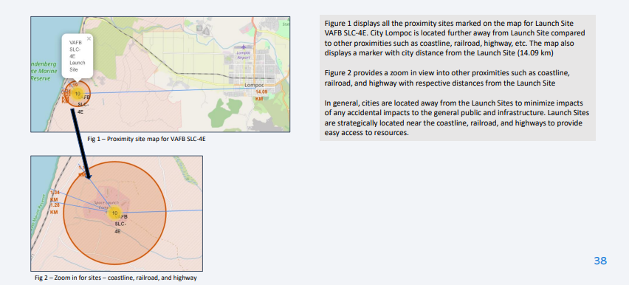
Space X Falcon9 – Launch Site to proximity Distance Map

Slide 38

Section 4

Slide 39
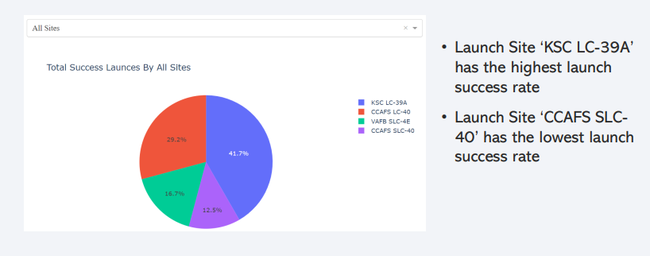
Launch Success Count For All Sites

Slide 40
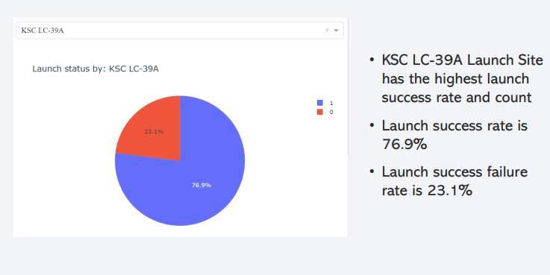
Launch Site with Highest Launch Success Ratio

Slide 41
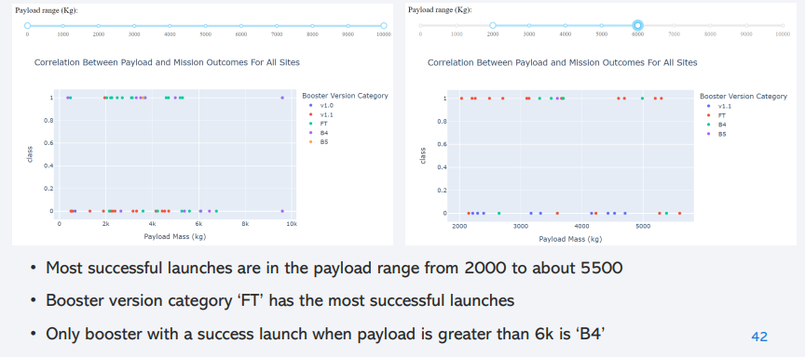
Payload vs. Launch Outcome Scatter Plot for all sites

Slide 42

Section 5

Slide 43
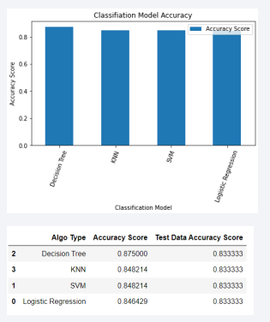
Classification Accuracy
Based on the Accuracy scores and as also
evident from the bar chart, Decision Tree
algorithm has the highest classification score
with a value of .8750
Accuracy Score on the test data is the same
for all the classification algorithms based on
the data set with a value of .8333
Given that the Accuracy scores for
Classification algorithms are very close and
the test scores are the same, we may need a
broader data set to further tune the models

Slide 44
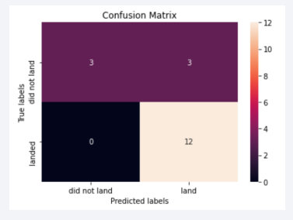
Confusion Matrix
• The confusion matrix is same for all the models (LR, SVM, Decision Tree, KNN)
• Per the confusion matrix, the classifier made 18 predictions
• 12 scenarios were predicted Yes for landing, and they did land successfully (True positive)
• 3 scenarios (top left) were predicted No for landing, and they did not land (True negative)
• 3 scenarios (top right) were predicted Yes for landing, but they did not land successfully (False positive)
• Overall, the classifier is correct about 83% of the time ((TP + TN) / Total) with a misclassification or error rate ((FP + FN) / Total) of about 16.5%

Slide 45
Conclusions
As the numbers of flights increase, the first stage is more likely to land successfully
Success rates appear go up as Payload increases but there is no clear correlation between
Payload mass and success rates
Launch success rate increased by about 80% from 2013 to 2020
Launch Site ‘KSC LC-39A’ has the highest launch success rate and Launch Site ‘CCAFS SLC40’ has the lowest launch success rate
Orbits ES-L1, GEO, HEO, and SSO have the highest launch success rates and orbit GTO the
lowest
Lunch sites are located strategically away from the cities and closer to coastline, railroads,
and highways
The best performing Machine Learning Classfication Model is the Decision Tree with an
accuracy of about 87.5%. When the models were scored on the test data, the accuracy
score was about 83% for all models. More data may be needed to further tune the models
and find a potential better fit.

Slide 46


